Slide 1




Internship At Applicate AI

Slide 2

INTRODUCTION
Name => Sakshi Rastogi
Enrollment Number => E18CSE159
Role => Software Engineer Trainee
Mentor Name => Kunal Bathla & Manish Srivastava

Slide 3

TABLE OF CONTENTS
2
1
3
4
5
About Company
Company’s Product
Company’s Tech Stack
My Tech Stack
Work Description

Slide 4


ABOUT THE COMPANY
Applicate AI is a leading Sales-Tech Company
It was founded in 2014 by Deepak Rewadi
It has funding of around $1.6 M
It has created first B2B platform (Channel KART)

Slide 5
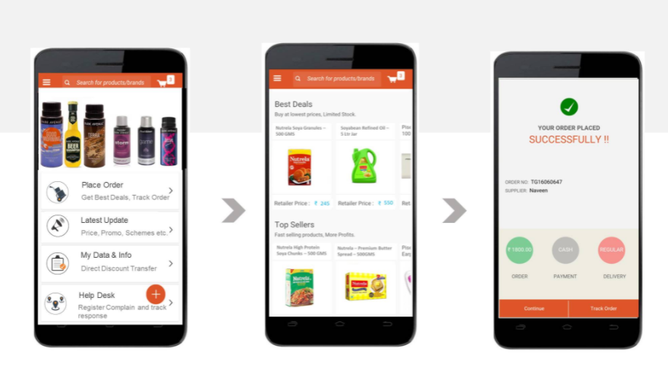


COMPANY’S PRODUCT
Applicate AI
SELLINA
CHANNEL KART
AI Sales Bot
Retailer App for Real-Time Sales Order

Slide 6








COMPANY’S TECHNOLOGY STACK
Front End :- HTML (Hypertext Markup Language) , CSS (Cascading Style Sheets), JavaScript, TypeScript
Back End :- Java and Spring Boot
Database :- IndexedDB and MySQL
Caching :- Redis

Slide 7



MY TECHNOLOGY STACK
TypeScript
JavaScript
Git
Jest

Slide 8

WORK DESCRIPTION
Device Management Service
Replaced 200 ajax requests with our own service.
Manually tested 200 ajax requests after replacement with our own service

Slide 9



DEVICE MANAGEMENT SERVICE
Device Management Service (Implementation + Integration + Test Cases)
Camera (Android, IOS)
Scanner (Android, IOS, Web)
App Update (Android, IOS)
Did implementation of the above mentioned services in typescript as typescript is less error prone than javascript
Wrote test cases of the above mentioned services using jest framework

Slide 10
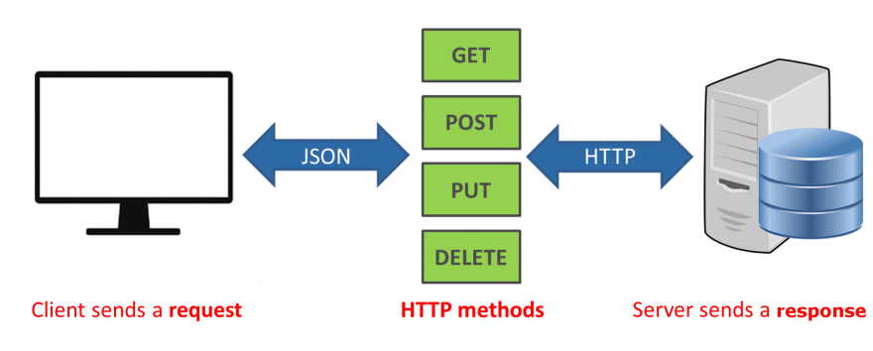
REPLACEMENT OF 200 AJAX REQUESTS
Replacement of Ajax Request with our own service (Implementation + Manual Testing)
Get Request- This type of request is used to get the data from the server.
Post Request- This type of request is used to send the data to the server.
Put Request - This type of request is used to send the data to the server in order to create the resource or update the resource (idempotent).
Delete Request - This type of request is used to delete a resource from the server .

Slide 11

COMPANY’S AGENDA
Applicate AI is planning to replace all the existing JavaScript code to TypeScript code as TypeScript is less error prone than JavaScript. So, they gave us 1 week training on TypeScript and now each fresher gets one service to write in TypeScript and create structure by your own and integrate it with UI.

Slide 12
WHAT I HAVE LEARNT ?
TOOLS
Android Studio (For Android)
XCode (For IOS)
VSCode
TECHNOLOGIES
Cordova and its plugins
JEST Framework (for writing test cases)
TypeScript
JavaScript
Git

Slide 13

THANK YOU
The expert in anything was once a beginner

